Slide 1


Engineering Analytics & Machine Learning
(ECSE202)
Seminar 6
Machine Learning
Linear Regression
AY2018/2019 OCT SEMESTER

Slide 2
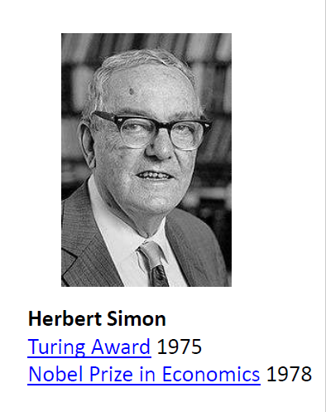
Machine Learning
Herbert Alexander Simon:
“Learning is any process by which a system improves performance from experience.”
“Machine Learning is concerned with computer programs that automatically improve their performance through experience.”

Slide 3
Machine Learning Main Tasks
• Develop systems that can automatically adapt and customize themselves to individual users.
– Personalized news or mail filter
• Discover new knowledge from large databases
– Market basket analysis (e.g. diapers and beer)
AY2018/2019 OCT SEMESTER

Slide 4
Machine Learning Main Tasks
• Ability to mimic human and replace certain monotonous tasks which require some intelligence.
• like recognizing handwritten characters
• Develop systems that are too difficult/expensive to construct manually because they require specific detailed skills or knowledge tuned to a specific task (knowledge engineering bottleneck).
AY2018/2019 OCT SEMESTER

Slide 5

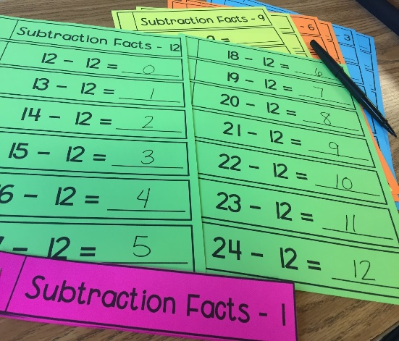
Human Learning
Show sample of examples for learning
Not for the kid to be fixed to the material
Able to apply
Able to extrapolate
Able to adapt to similar cases
Able to innovate
Notes:
Emphasis the aim of we showing sample of examples such as flash card is not for kids to learn by hard the actual loo of the card. But instead to be able to adapt and still recognize a ‘A’ that is smaller or bigger or rotated.

Slide 6

Generalize
Not to fit the train data
Notes:
Emphasis again that the aim of AI is not to fit the train data but to generalize
Generalize mean able to adapt and handle data that the model had not seen before during training.

Slide 7
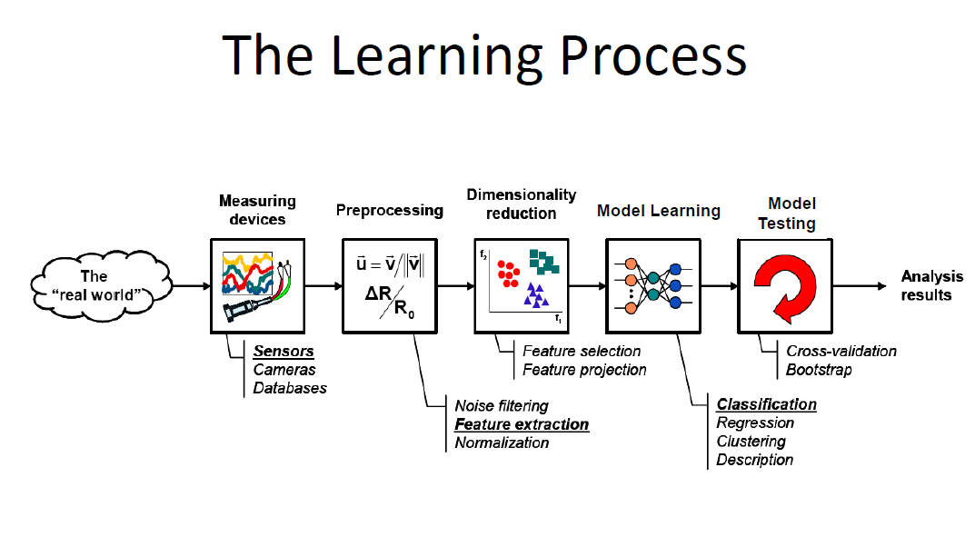

Slide 8
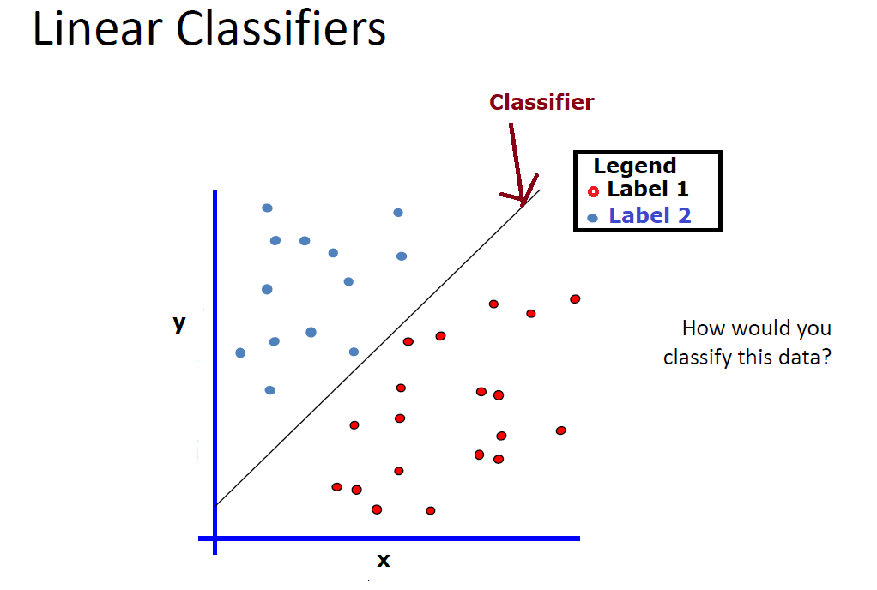
Linear Regression Y=ax+b where a is the slope and b is the y-intercept

Slide 9
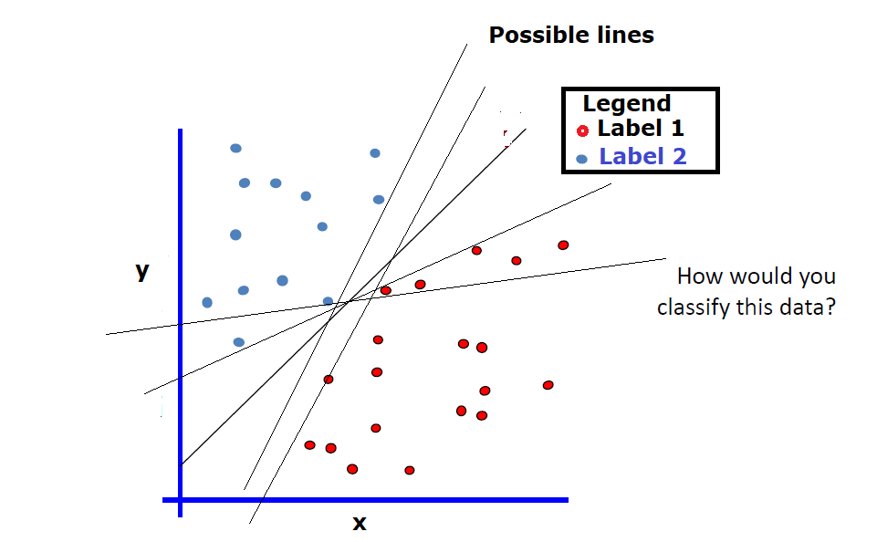
By changing the value of a and b, we could have many possible lines as classifier, which one could achieve the best performance?

Slide 10
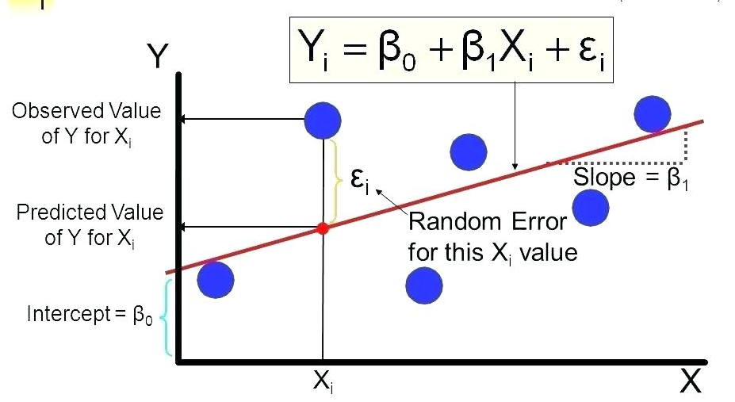
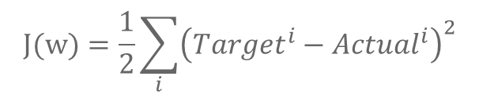
Cost Function
Linear regression tries to fit points to a line generated by an algorithm. This optimized line (the model) is capable of predicting values for certain input values and can be plotted. The square error is the commonly cost function to optimize and find the best line that have produce the lowest square error.
$$J(w)=\frac{1}{2}\sum_{i}{{\left({Target}^{i}−{Actual}^{i}\right)}^{2}}$$
AY2018/2019 OCT SEMESTER

Slide 11

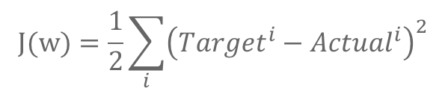
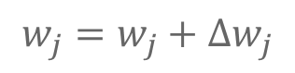
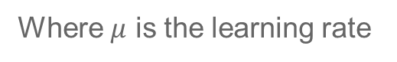
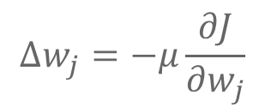
Gradient Descent (GD)
$$J(w)=\frac{1}{2}\sum_{i}{{\left({Target}^{i}−{Actual}^{i}\right)}^{2}}$$
$$∆w_{j}=−μ\frac{∂J}{∂w_{j}}$$
$$w_{j}=w_{j}+∆w_{j}$$
Where $μ$ is the learning rate
Source: https://www.quora.com/Whats-the-difference-between-gradient-descent-and-stochastic-gradient-descent
Gradient Descent is a effective yet simple optimization method commonly adapted in machine learning.
Notes:
If the initial weight is at right side of the curve, the gradient would be positive, that mean delta w would negative which move toward the global cost minimum.
If the weights are at the left side of the curve, the gradient would be negative, that mean delta w would be positive which also move toward the global cost minimum

Slide 12
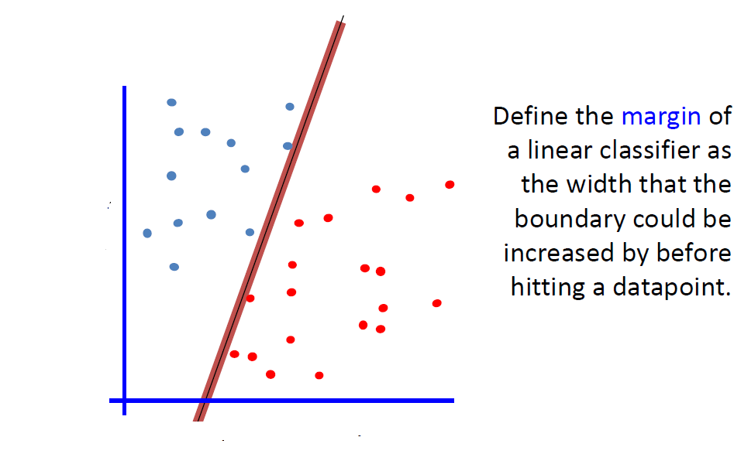

Slide 13
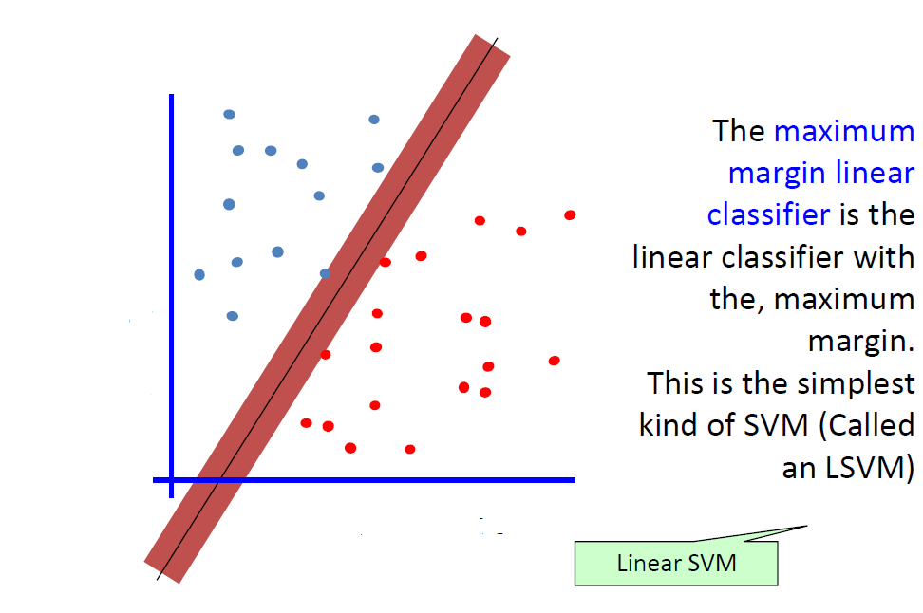

Slide 14
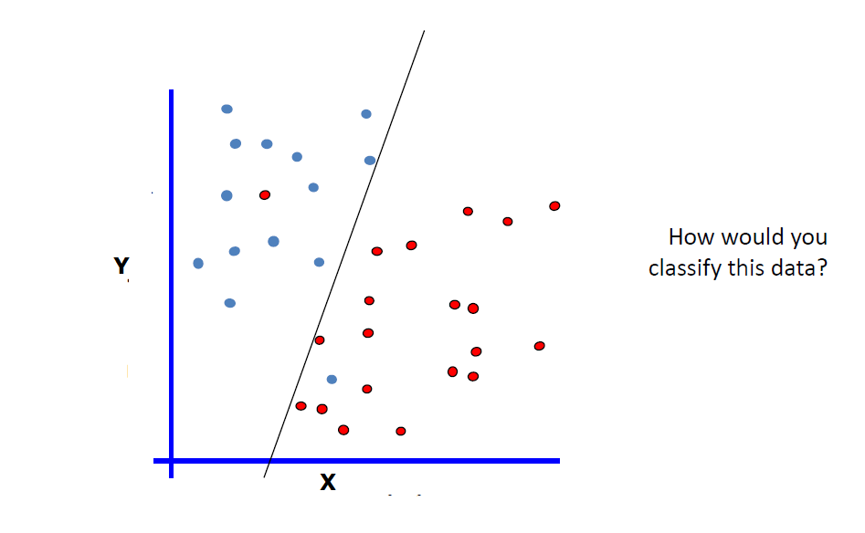
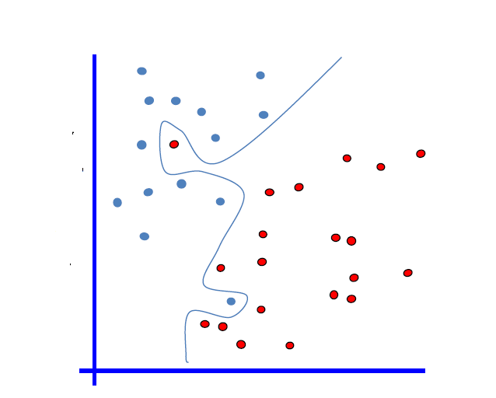
No linear classifier can cover all instances.
Non-Linear classifier is required

Slide 15

Linear Regression
https://www.youtube.com/watch?v=CtKeHnfK5uA
AY2018/2019 OCT SEMESTER

Slide 16
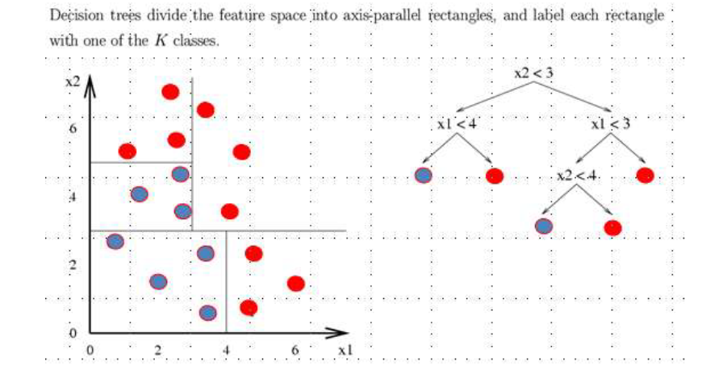
A flow-chart like tree structure
Internal node denotes a test on an attribute
Branch represents an outcome of the test
Leaf nodes represents an outcome of the test
Leaf nodes represent class labels or class distribution

Slide 17
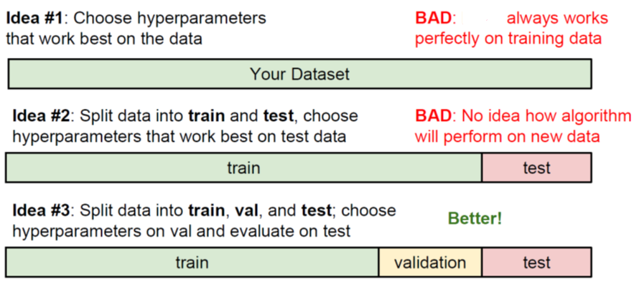
Data Split
AY2018/2019 OCT SEMESTER
9

Slide 18
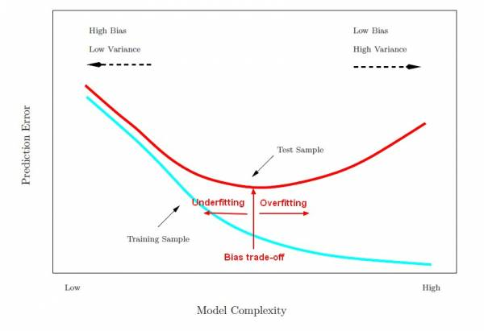
Under fitting and Overfitting
AY2018/2019 OCT SEMESTER
11

Slide 19
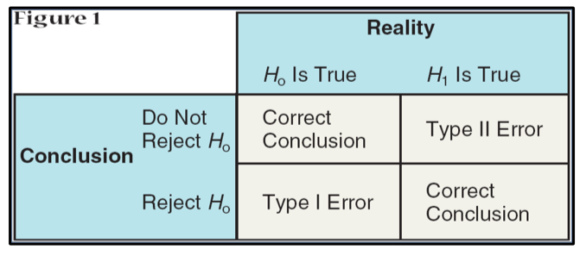
Type I & II Errors
AY2018/2019 OCT SEMESTER
11

Slide 20
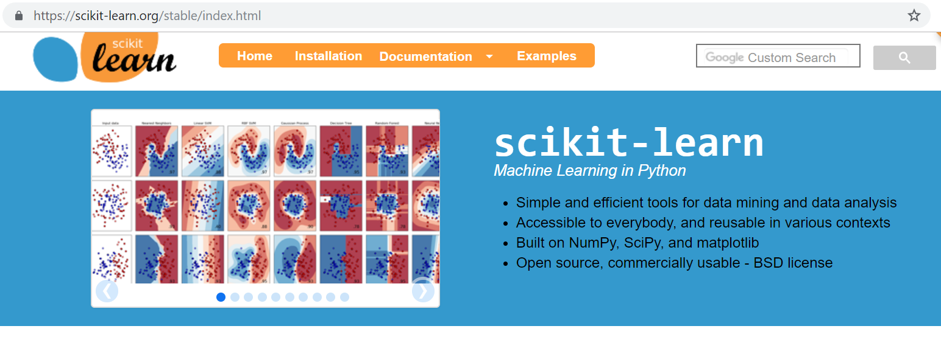
scikit-learn
Machine Learning in Python
https://scikit-learn.org/stable/index.html
AY2018/2019 OCT SEMESTER
11

Slide 21
scikit-learn commonly used steps
Commonmly steps in using the Scikit-Learn estimator API:
Choose a class of model by importing the appropriate estimator class from Scikit-Learn
Choose model hyperparameters by instantiating this class with desired values
Arrange data into a feature matrix and target vector
Fit the model to data by call the fit() method of the model instance.
Apply the model to new data:
For supervised learning, we predict labels for unknown data using the predict() methhod
For unsupervised learning, we often transform or infer properties of the data using the transform or predict() methods
AY2018/2019 OCT SEMESTER
11

Slide 22
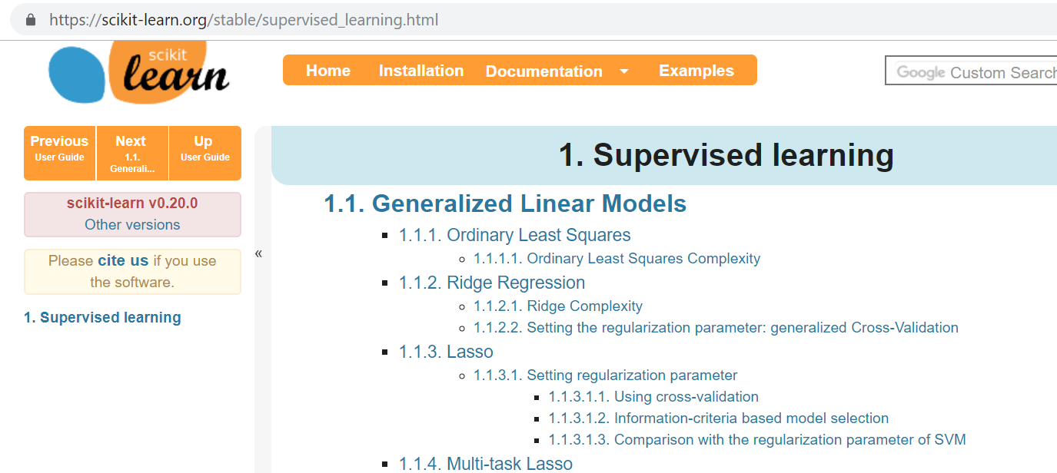
Choosing a class of model
https://scikit-learn.org/stable/supervised_learning.html#supervised-learning
AY2018/2019 OCT SEMESTER
11

Slide 23
SCKIT Model Fit
Train Feature Matrix (x)
n_features
Training Target vector(y)
Scikit Model fit()
train_samples
train_samples
Trained Model
AY2018/2019 OCT SEMESTER
11
Notes:
Emphasis on the shape of the input data to the fit function, it had to be in train_samplexn_features
While target vector had to be train_samples vector

Slide 24
SCKIT Model Predict
Test Feature Matrix (x)
n_features
Test Target vector(y)
Scikit Model Predict()
Performance Evaluation
test_samples
test_samples
Test Accuracy
AY2018/2019 OCT SEMESTER
11

Slide 25
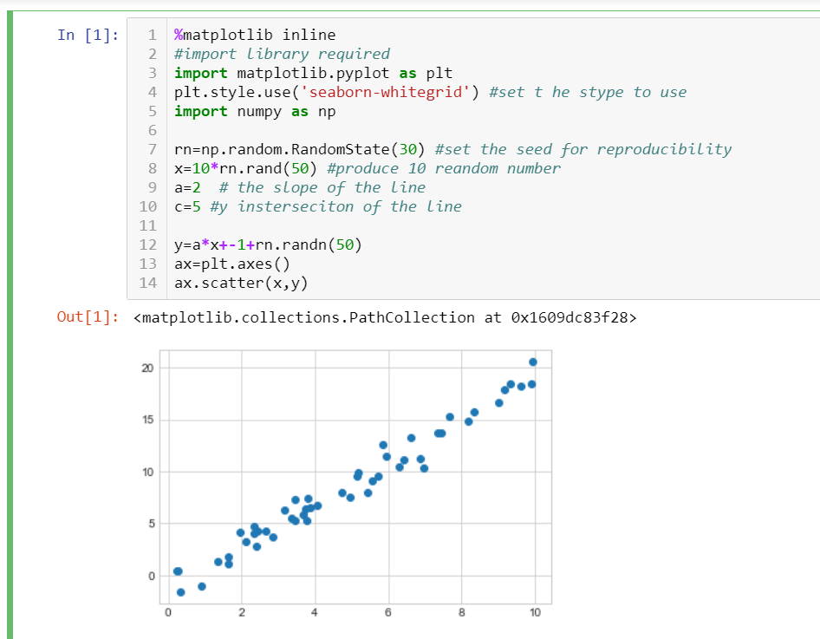
Simple Linear Example
Generate a 2-dimensional data x and y
The relationship is linear y=ax+b
X is randomly generated
AY2018/2019 OCT SEMESTER
11

Slide 26
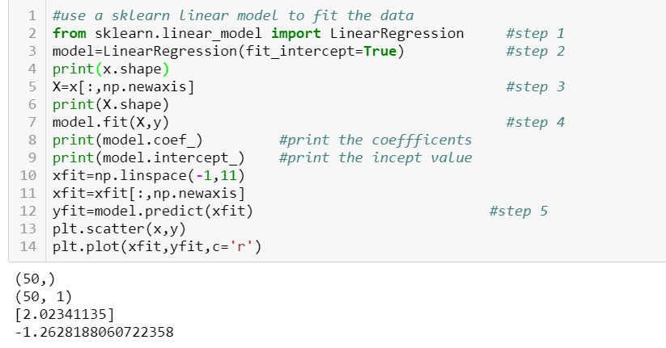
Simple Linear Example
Import chosen Linear Regression model
initialize the class with desired hyperparameter
Arrange data into a feature matrix
Fit the model to data by call the fit() method
Apply the model for evaluation
AY2018/2019 OCT SEMESTER
11

Slide 27

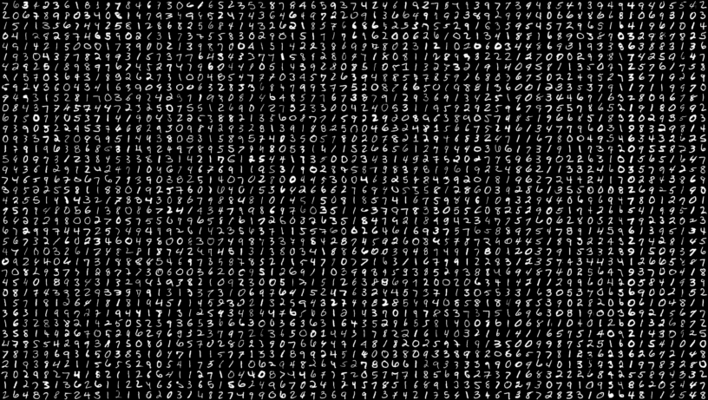
MNIST Handwritten Dataset
11

Slide 28
MNIST Handwritten Dataset
The MNIST database (Modified National Institute of Standards and Technology database) is a large database of handwritten digits that is commonly used for training various image processing systems.
The database is also widely used for training and testing in the field of machine learning.
It was created by "re-mixing" the samples from NIST's original datasets. Half of the training set and half of the test set were taken from NIST's training dataset, while the other half of the training set and the other half of the test set were taken from NIST's testing dataset.
The MNIST database contains 60,000 training images and 10,000 testing images.
More information on the digit dataset from Sickit:
http://scikit-learn.org/stable/auto_examples/datasets/plot_digits_last_image.html
Detail information on the digit dataset from UCI:
http://archive.ics.uci.edu/ml/datasets/PenBased+Recognition+of+Handwritten+Digits
11

Slide 29
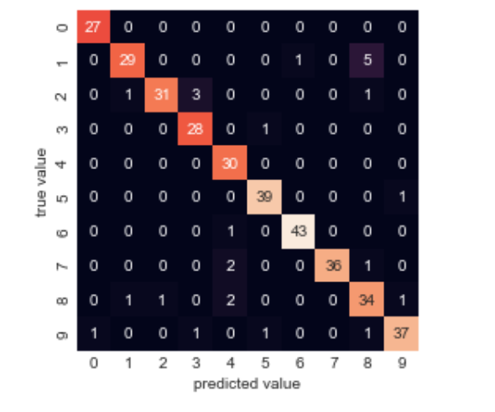
0.9277777777777778
Confusion Matrix for Classification
0.9277777777777778
Confusion Matrix plotted as heat-map for SGDClassifier for MNIST Handwritten Dataset with classification accuracy of 92%
11
Notes:
Explain how to interpret the confusion matrix
Also it is used to further improve the performance by isolating the wrong classification cases and work on them.

